Slide 1
Large Scale Realistic Ocean Rendering and Simulation
Spencer McKean

Slide 2
Agenda
Background
Early Experimentations
Initial Implementations
Performance Improvements
Results

Slide 3
Agenda
Background
Early Experimentations
Initial Implementations
Performance Improvements
Results

Slide 4
Introduction
Background Early Experimentations Initial Implementations Performance Improvements Results
Inspired by Sea of Thieves
Large scale ocean surface simulation
Large scale interactive waves
Analyze Performance impact of different portions

Slide 5
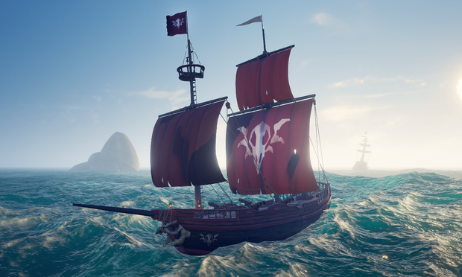
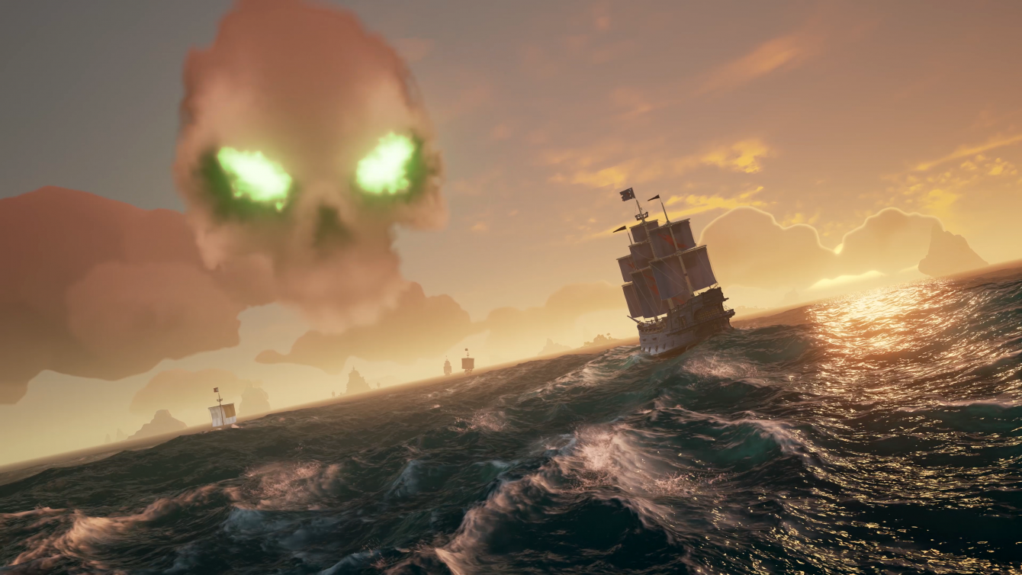
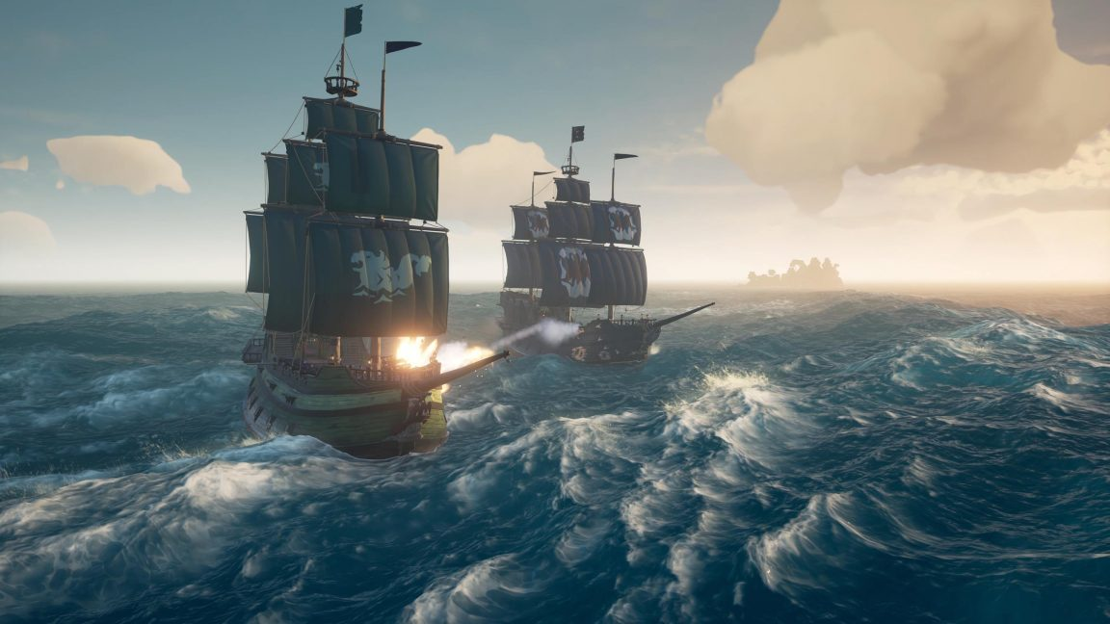
Background Early Experimentations Initial Implementations Performance Improvements Results
Figure 1: Sea of Thieves screenshot [1]
Figure 2: Sea of Thieves screenshot [2]
Figure 3: Sea of Thieves screenshot [3]

Slide 6
Agenda
Background
Early Experimentations
Initial Implementations
Performance Improvements
Results

Slide 7
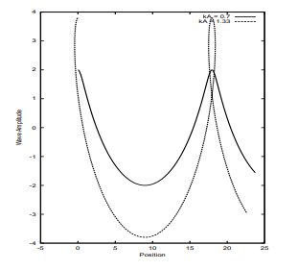
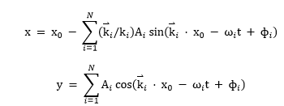
Gerstner Waves
Background Early Experimentations Initial Implementations Performance Improvements Results
Figure 5: Gerstner Wave Equations [4]
Figure 4: Potential issues with Gerstner Waves [4]

Slide 8
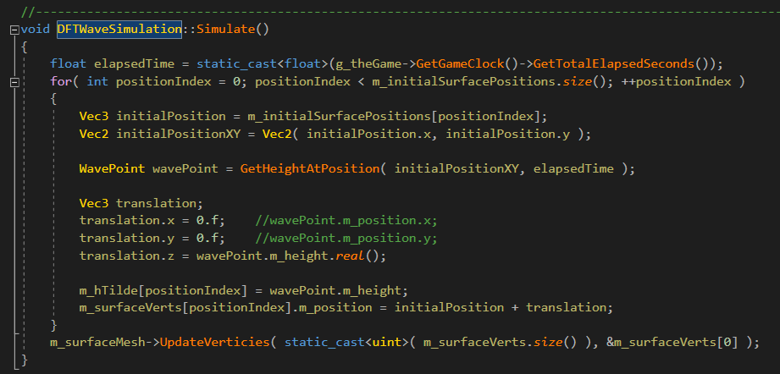
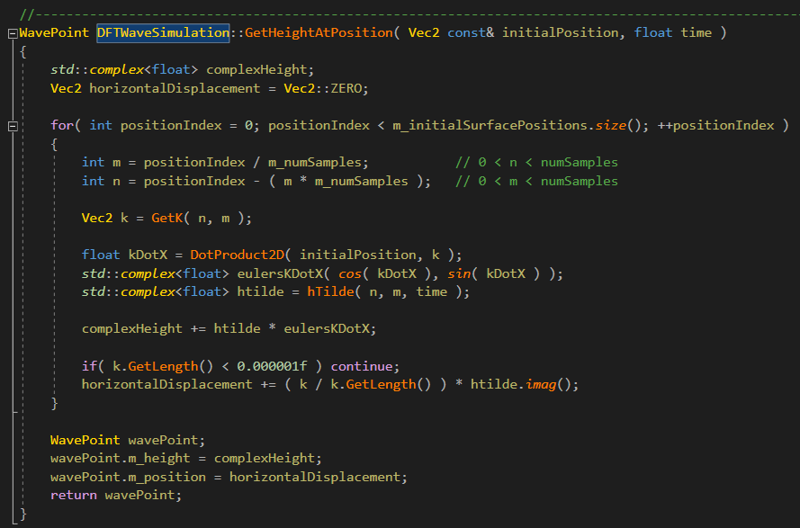
Discrete Fourier Transform (DFT) Waves
Background Early Experimentations Initial Implementations Performance Improvements Results
Figure 6: Implementation of DFT Waves
Figure 7: Implementation of DFT Waves

Slide 9
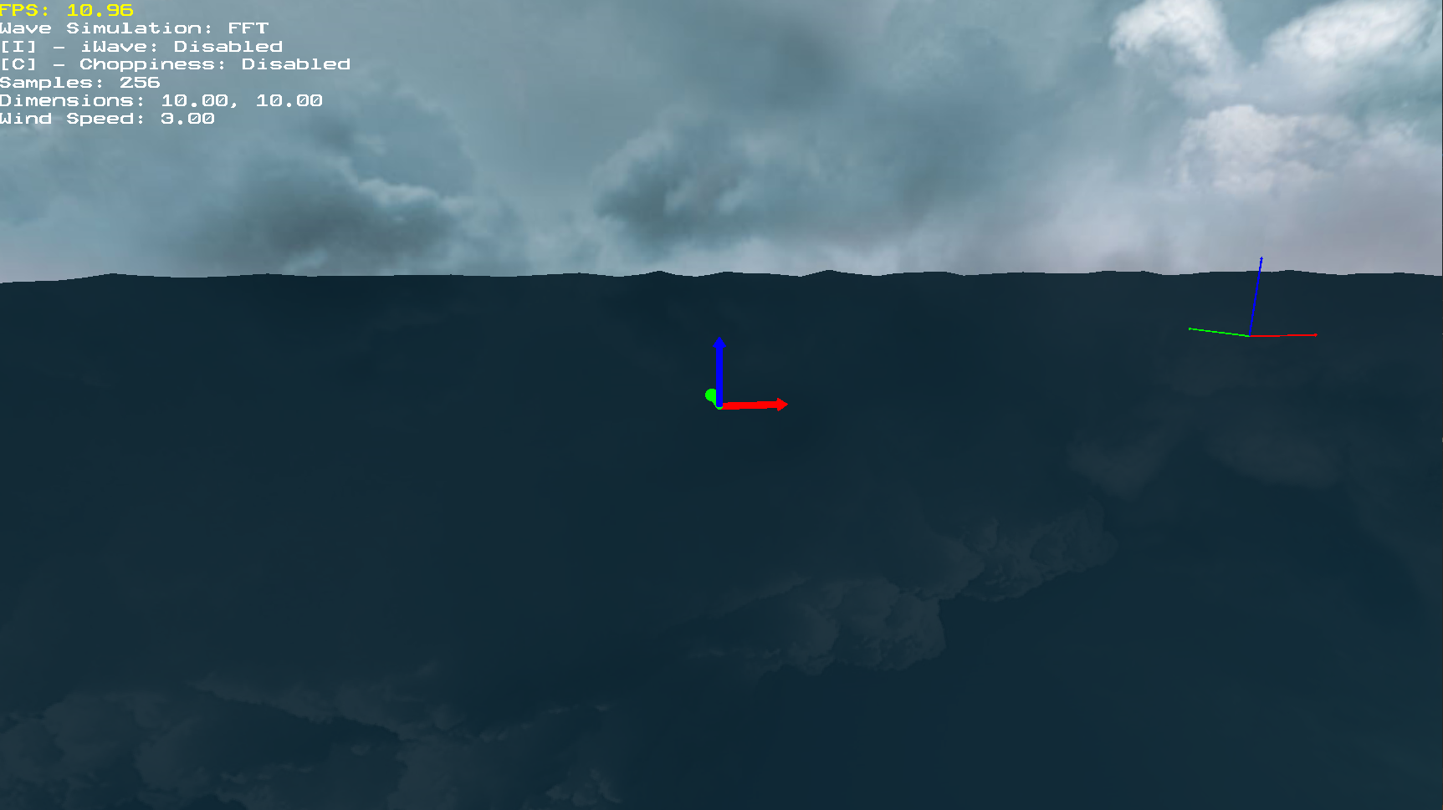
Discrete Fourier Transform Waves
Background Early Experimentations Initial Implementations Performance Improvements Results
Figure 8: Implementation of DFT Waves

Slide 10
Agenda
Background
Early Experimentations
Initial Implementations
Performance Improvements
Results

Slide 11
FFT with Multiple Arrays
Background Early Experimentations Initial Implementations Performance Improvements Results

Slide 12
Agenda
Background
Early Experimentations
Initial Implementations
Performance Improvements
Results

Slide 13
Performance Improvements
Background Early Experimentations Initial Implementations Performance Improvements Results
Wave vertex data structure
Threaded FFT
Compute Shader FFT

Slide 14
Agenda
Background
Early Experimentations
Initial Implementations
Performance Improvements
Results

Slide 15
Preliminary Results
Background Early Experimentations Initial Implementations Performance Improvements Results
DFT not manageable at interactive speeds
FFT on one thread at a low number of samples
iWave impacts performance

Slide 16
Background Early Experimentations Initial Implementations Performance Improvements Results

Slide 17
Background Early Experimentations Initial Implementations Performance Improvements Results

Slide 18
References
Background Early Experimentations Initial Implementations Performance Improvements Results
[1] | K. Stuart, "Sea of Thieves: How Rare Silenced the Cannons and Brought Peace to the Seas," 18 July 2018. [Online]. Available: https://www.theguardian.com/games/2018/jul/18/sea-of-thieves-rare-games-update-the-hungering-deep-cursed-sails-forsaken-shores. [Accessed 19 July 2020].
[2] | M. Ruiz, "Sea of Thieves Review — A Whole Lot of Booty," 29 March 2018. [Online]. Available: https://www.dualshockers.com/sea-of-thieves-review-xbox-one/. [Accessed 19 July 2020].
[3] | M. Martin, "Sea of Thieves Reviews Round-up – All the Scores for Rare’s Wonky Pirate Adventure," 22 March 2018. [Online]. Available: https://www.vg247.com/2018/03/22/sea-of-thieves-reviews-scores/. [Accessed 19 July 2020].
[4] | J. Tessendorf, "Simulating Ocean Water," 2004. [Online]. Available: https://people.cs.clemson.edu/~jtessen/reports/papers_files/coursenotes2004.pdf.

